Slide 1
Introduction to SQL
A Beginner’s Guide
Nasirdin Sola

Slide 2
What is Data?
Key Points:
- Data is information that can be stored and used.
- Examples: Names, numbers, addresses, etc.
Notes:
To start, let’s talk about what data is. Simply put, data is information. This could be anything from names and addresses to numbers and statistics. We encounter data every day, and it’s the foundation of many systems and applications we use. Think of it like the raw materials for storing and retrieving information

Slide 3
What is a Database?
Key Points:
- A database is a place where data is stored.
- It’s like a digital filing cabinet for organized data.
Notes:
Now that we know what data is, where do we store it? In databases! A database is a structured collection of data. Imagine a digital filing cabinet, but instead of paper files, it organizes and stores data electronically. This makes it easier to retrieve, update, and manage the data efficiently.

Slide 4
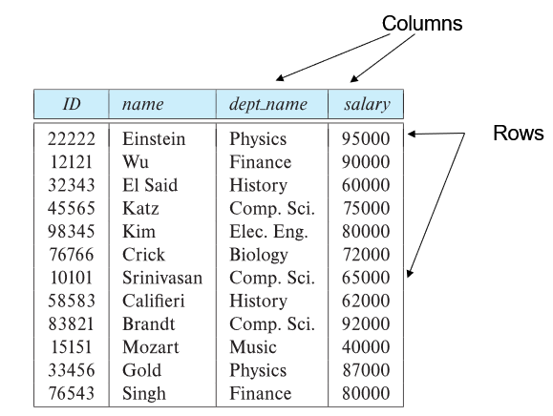
Introduction to SQL
Key Points:
- SQL stands for Structured Query Language.
- It’s a language used to communicate with databases.
Notes:
So, how do we interact with databases? We use a language called SQL, which stands for Structured Query Language. SQL is the standard language used to communicate with databases. Whether we’re retrieving information or updating it, SQL is the tool we use

Slide 5
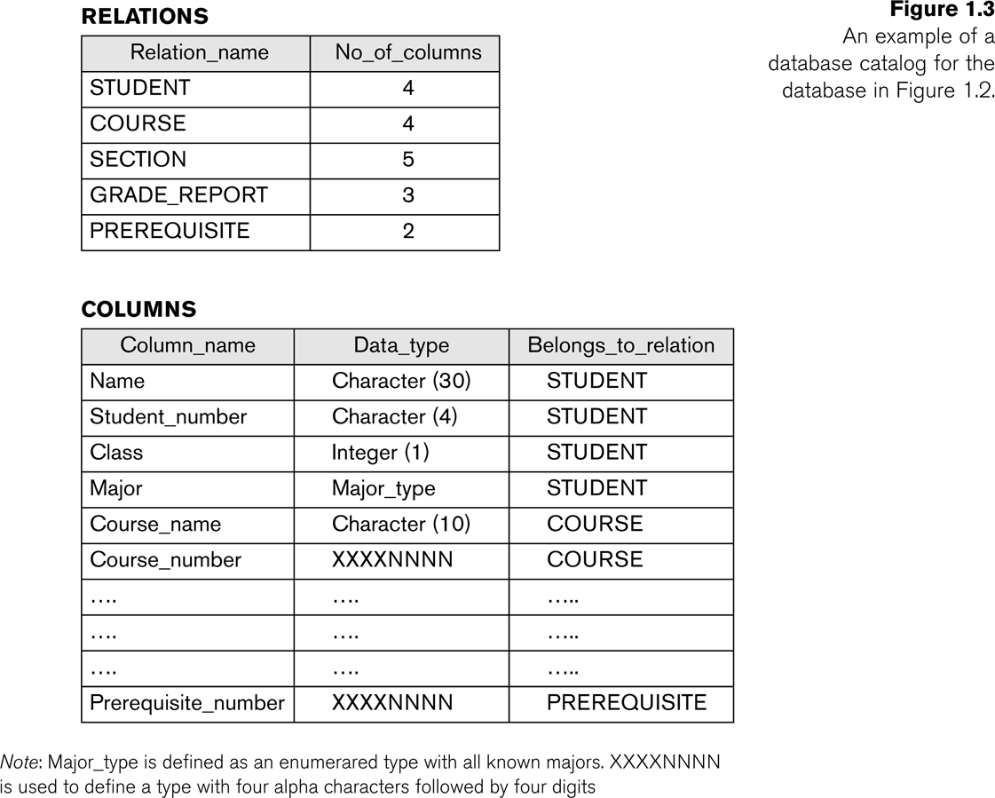
Example of a Simplified Database Catalog

Slide 6
Why Use SQL?
Key Points:
- SQL helps in creating, reading, updating, and deleting data.
- It’s widely used by websites and apps to manage data.
Notes:
But why SQL? SQL allows us to perform essential operations on data. These include creating tables to store data, reading or querying the data, updating existing information, and even deleting data when it’s no longer needed. SQL is widely used in websites and applications because it’s reliable and easy to learn

Slide 7
CRUD Operations Overview
SQL commands are often categorized as CRUD operations:
- Create: INSERT
- Read: SELECT
- Update: UPDATE
- Delete: DELETE

Slide 8
SELECT Command (Retrieving Data)
The SELECT command is used to retrieve data from a database.
Example:
SELECT * FROM students;
You can retrieve specific columns:
SELECT Name, Age FROM students;
Filter results using WHERE:
SELECT * FROM students WHERE Age > 18;

Slide 9
INSERT Command (Adding Data)
The INSERT command adds new data to a table.
Example:
INSERT INTO
students (ID, Name, Age)
VALUES (1, 'John Doe', 20);
Specify both column names and values to add data correctly.
Notes:
After creating a table, we need to add data to it. This is done using the INSERT command. In this example, we’re adding a student with ID 1, named 'John Doe,' who is 20 years old. The data is now saved in the database, ready for retrieval.

Slide 10
UPDATE Command (Modifying Data)
The UPDATE command modifies existing data in a table.
Example:
UPDATE students
SET Age = 21
WHERE ID = 1;
Always use the WHERE clause to target specific rows.

Slide 11
DELETE Command (Removing Data)
The DELETE command removes data from a table.
Example:
DELETE FROM students
WHERE ID = 1;
Always specify the WHERE clause to avoid deleting all records.

Slide 12
Creating a Table
Key Points:
Example: CREATE TABLE students ( ID int, Name varchar(255), Age int );
Notes:
One of the first things we do when working with a database is create tables to store data. Here’s an example of how we would create a table for students in SQL. We define the columns – ID, Name, and Age – and specify their data types. This is how we structure and organize our data.

Slide 13
Conclusion
Key Points:
- SQL is a simple yet powerful way to manage data.
- Learning SQL opens opportunities in data management and programming.
Notes:
To wrap things up, SQL is a straightforward yet powerful tool for managing data in a database. Whether you're working with small datasets or large systems, learning SQL can open doors to many opportunities in data management, programming, and web development. I hope this introduction gave you a clearer idea of how SQL works and why it’s so important

Slide 14
TODO:
Register to:
GitHub
https://github.com/
Neon.tech (with GitHub account)
https://neon.tech/
Google Sheets
https://tinyurl.com/2s3dwcdy

Slide 15
DATA TYPES

